Slide 1
Computer Arithmetic
Nazmun Nessa Moon
Assistant Professor
Department of CSE
Daffodil International University

Slide 2
Learning Objectives
In this lecture you will learn about:
Reasons for using binary instead of decimal numbers
Basic arithmetic operations using binary numbers
Addition (+)
Subtraction (-)
Multiplication (*)
Division (/)

Slide 3
Binary over Decimal
Information is handled in a computer by electronic/ electrical components
Electronic components operate in binary mode (can only indicate two states – ON (1) or OFF (0)
Binary number system has only two digits (0 and 1), and is suitable for expressing two possible states
In binary system, computer circuits only have to handle two binary digits rather than ten decimal digits causing:
Simpler internal circuit design
Less expensive
More reliable circuits
Arithmetic rules/processes possible with binary numbers

Slide 4
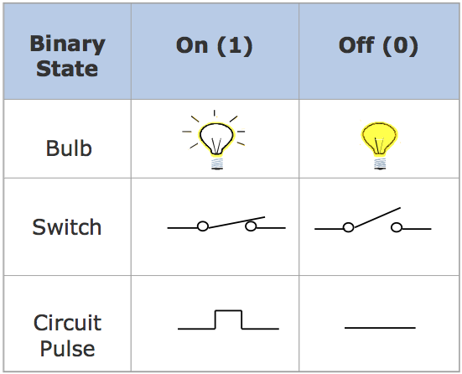
Examples of a Few Devices that work in Binary Mode Binary

Slide 5
Binary Number System
System Digits: 0 and 1
Bit (short for binary digit): A single binary digit
LSB (least significant bit): The rightmost bit
MSB (most significant bit): The leftmost bit
Upper Byte (or nybble): The right-hand byte (or nybble) of a pair
Lower Byte (or nybble): The left-hand byte (or nybble) of a pair
The term nibble used for 4 bits being a subset of byte.

Slide 6
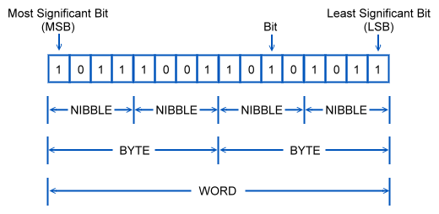
Binary Number System

Slide 7
Binary Equivalents
1 Nybble (or nibble) = 4 bits
1 Byte = 2 nybbles = 8 bits
1 Kilobyte (KB) = 1024 bytes
1 Megabyte (MB) = 1024 kilobytes = 1,048,576 bytes
1 Gigabyte (GB) = 1024 megabytes = 1,073,741,824 bytes

Slide 8
Binary Arithmetic
Binary arithmetic is simple to learn as binary number system has only two digits – 0 and 1
Following slides show rules and example for the four basic arithmetic operations using binary numbers

Slide 9
Binary Addition
Rule for binary addition is as follows:
0 + 0 = 0
0 + 1 = 1
1 + 0 = 1
1 + 1 = 0 plus a carry of 1 to next higher column

Slide 10
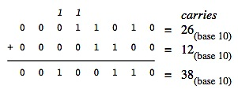
Binary Addition
Example 1: 00011010₂ + 00001100₂ = 00100110₂

Slide 11
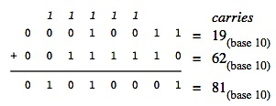
Binary Addition
Example 2: 00010011₂ + 00111110₂ = 01010001₂

Slide 12
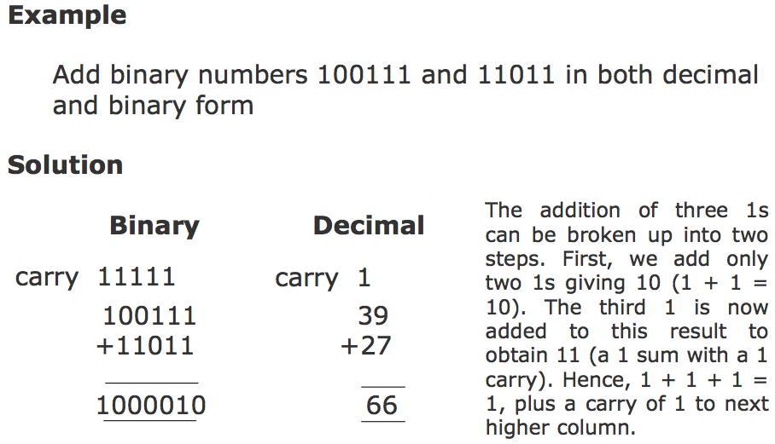
Binary Addition (Example 3)

Slide 13
Binary Subtraction
Rule for binary subtraction is as follows:
0 - 0 = 0
0 - 1 = 1 with a borrow from the next column
1 - 0 = 1
1 - 1 = 0

Slide 14
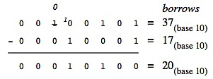
Binary Subtraction
Example 1: 00100101₂ - 00010001₂ = 00010100₂

Slide 15
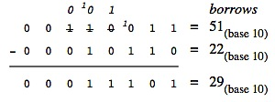
Binary Subtraction
Example 2: 00110011₂ - 00010110₂ = 00011101₂

Slide 16
Binary Multiplication
Table for binary multiplication is as follows:
0 x 0 = 0
0 x 1 = 0
1 x 0 = 0
1 x 1 = 1

Slide 17
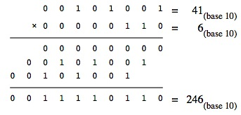
Binary Multiplication
Example 1: 00101001₂ × 00000110₂ = 11110110₂

Slide 18
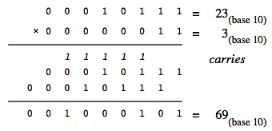
Binary Multiplication
Example 2: 00010111₂ × 00000011₂ = 01000101₂

Slide 19
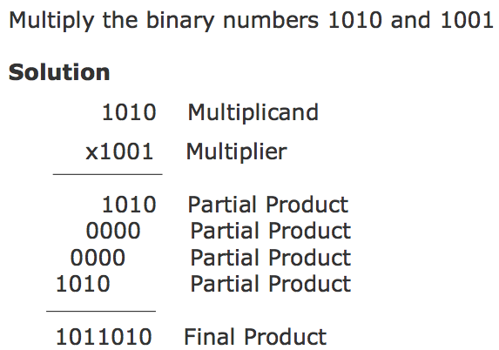
Binary Multiplication
Example 3:

Slide 20
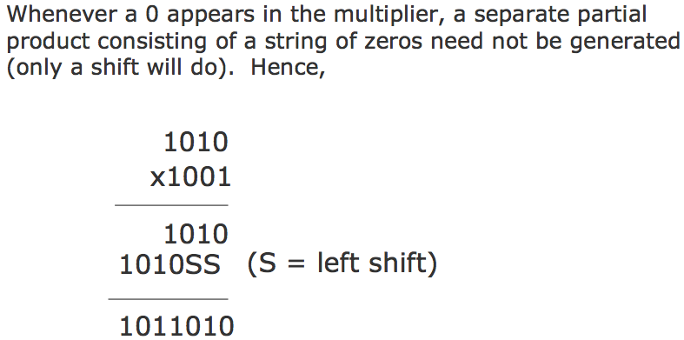
Binary Multiplication
Example 4:

Slide 21
Binary Division
Table for binary division is as follows:
0 ÷ 0 = Divide by zero error
0 ÷ 1 = 0
1 ÷ 0 = Divide by zero error
1 ÷ 1 = 1
As in the decimal number system (or in any other number system), division by zero is meaningless
The computer deals with this problem by raising an error condition called ‘Divide by zero’ error

Slide 22
Rules for Binary Division
Start from the left of the dividend
Perform a series of subtractions in which the divisor is subtracted from the dividend
If subtraction is possible, put a 1 in the quotient and subtract the divisor from the corresponding digits of dividend
If subtraction is not possible (divisor greater than remainder), record a 0 in the quotient
Bring down the next digit to add to the remainder digits. Proceed as before in a manner similar to long division

Slide 23
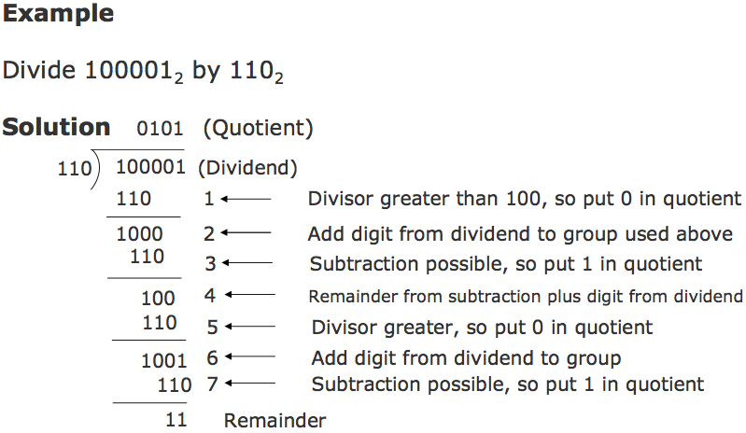
Binary Division (Example 1)

Slide 24
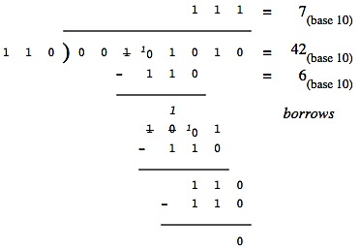
Binary Division (Example 2)
Example: 00101010₂ ÷ 00000110₂ = 00000111₂

Slide 25
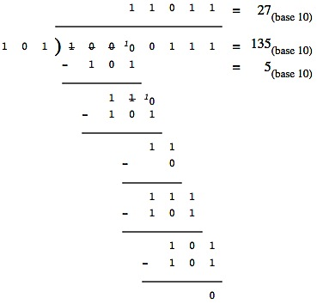
Binary Division (Example 3)
Example: 10000111₂ ÷ 00000101₂ = 00011011₂

Slide 26
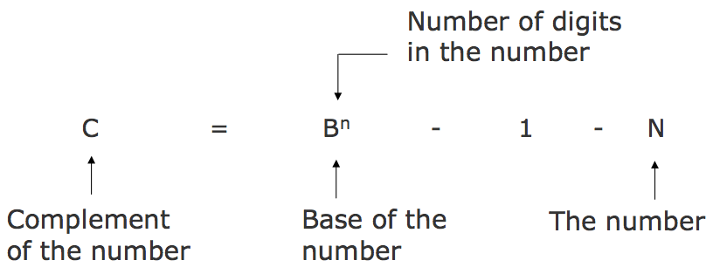
Complement of a Number

Slide 27
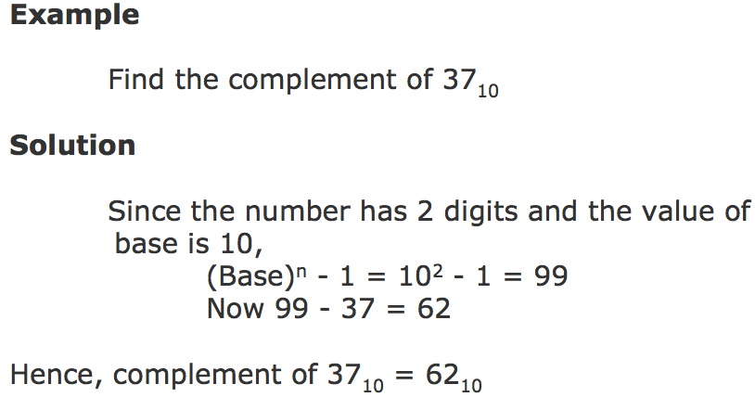
Complement of a Decimal Number

Slide 28
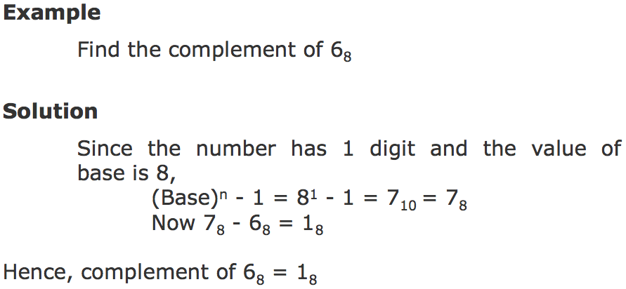
Complement of a Octal Number

Slide 29
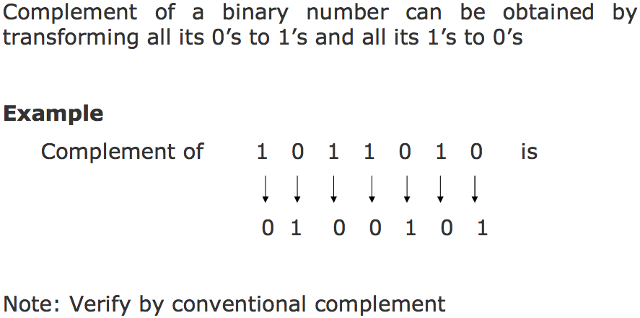
Complement of a Binary Number

Slide 30
Complementary Method of Subtraction
Involves following 3 steps:
Step 1: Find the complement of the number you are subtracting (subtrahend)
Step 2: Add this to the number from which you are taking away (minuend)
Step 3: If there is a carry of 1, add it to obtain the result; if there is no carry, recomplement the sum and attach a negative sign
Complementary subtraction is an additive approach of subtraction

Slide 31
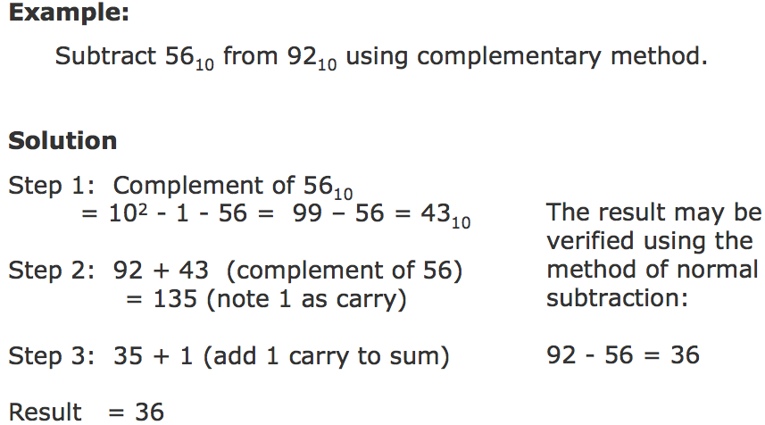
Complementary Subtraction (Example 1)

Slide 32
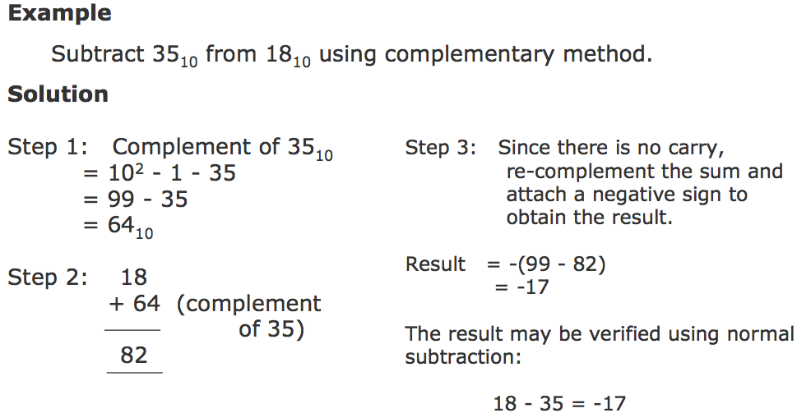
Complementary Subtraction (Example 2)

Slide 33
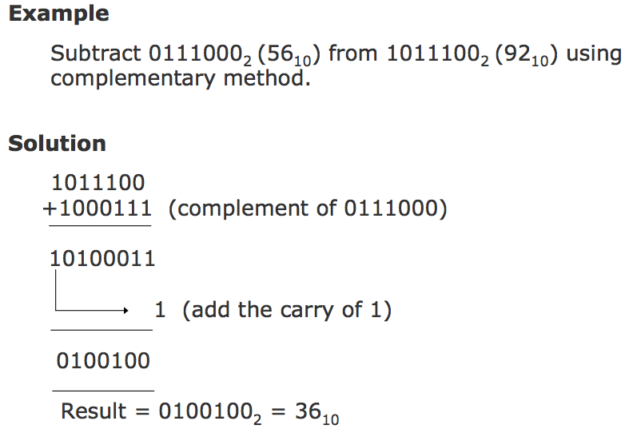
Binary Subtraction Using Complementary Method (Example 1)

Slide 34
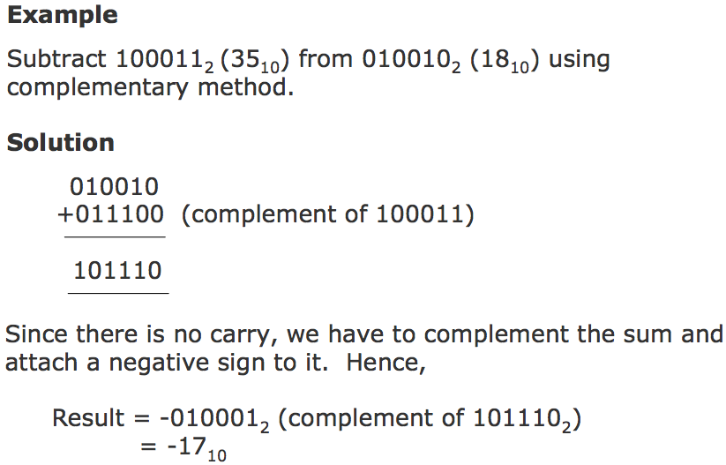
Binary Subtraction Using Complementary Method (Example 2)

Slide 35
Addition/Subtraction of Numbers in 2’s Complement Notation
Represent all negative numbers in 2’s complement form.
Now we have the same procedure for addition and subtraction.
Subtraction of a number is achieved by adding the 2’s complement of the number.
This is illustrated in the following example where the carry, if any, from the most significant bit, during addition, should be ignored.
The result has to be interpreted appropriately using the same convention.
35

Slide 36
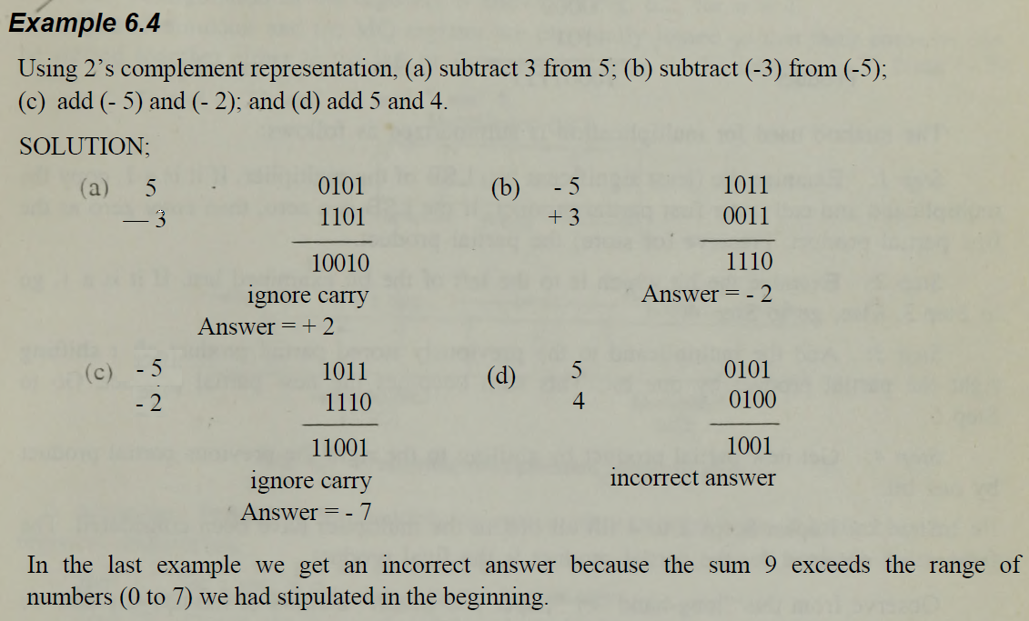
Addition/Subtraction of Numbers in 2’s Complement Notation…

Slide 37
Key Words/Phrases
Additive method of division
Additive method of multiplication
Additive method of subtraction Binary addition
Binary arithmetic Binary division
Binary multiplication Binary subtraction
Complementary subtraction Complement
Computer arithmetic

